Slide 1
Project work
gruppo 2 - software architecture design 2024/2025

Slide 2
USER STORIES & ACCEPTANCe CrITeriA
A total of 35 User Stories has been divided in 3 sprints, based on the team’s capacity. Each team member works for 8 hours during each sprint, which results in 32 total hours, since the team consists of 4 members.
Even though Story Points represent relative effort, we assigned 32 Story Points to the User Stories, according to their relative complexity, in order to match the team’s estimated capacity.
Each User Story was assigned a priority (must, should, could or won’t), based on its complexity and contribution to the entire project.

Slide 3
DEFINITION OF DONE
The user story implementation meets ALL the acceptance criteria.
The unit tests were written, executed and passed.
All acceptance criteria have at least a test case.
End-user documentation is available.
All the code has been properly documented.
All bugs fixed.
The interface is functional and consistent with the design.

Slide 4
1st sprint planning and backlog
The first sprint includes 18 User Stories, which allow the user to:
Create, place and color simple shapes
Copy (or cut) and paste shapes
Save and load the drawing
On the right there are some examples.
#US | Description | Priority | SPs
3 | Draw line segments | Must | 1
4 | Draw rectangles | Must | 1
6 | Choose the color | Must | 2
8 | Save my drawing | Must | 2
15 | Copy a shape | Should | 2

Slide 5
TOOLS, Languages & Frameworks
The main programming language used to develop the project is Java. The code is written using the IDE NetBeans.
The framework JavaFX is used to create the user interface, thanks to Scene Builder, a GUI Builder well integrated with NetBeans.
Testing is done via Maven with JUnit.
In order to apply the agile methodology Scrum, Trello is used as a shared board to keep track of User Stories, Sprint backlogs and other metrics useful to estimate the progress of the project.
The source code is shared on GitHub.

Slide 6
DESCRIPTION OF SOFTWARE ARCHITECTURE
The architecture used for this software is MVC, which consists of:
Model, that represents the data and encapsulates the application state. It notifies the View of changes.
View, that renders the Model to the user interface, where the user can interact with.
Controller, that defines the application behaviour and updates the Model according to user actions.
This architecture helps achieving loose coupling by dividing the data from the visualization of data itself.

Slide 7
DESIGN PATTERNS
Certain design patterns were adopted according to the principles of object-oriented design, so that the software is easier to maintain, expand and fix. In particular:
The Composite pattern allows multiple shapes to be grouped. The ShapeGroup class contains multiple Shape objects, but it can be used as if it were a normal shape. This allows us to apply the same operations to both single shapes and groups;
The Decorator pattern allows us to add extra functionality to shapes, such as border or fill colors.
The Strategy pattern allows shapes to be transformed (rotation, stretch, etc.), by treating each transformation as a separate strategy.

Slide 8
DESIGN PATTERNS
Certain design patterns were adopted according to the principles of object-oriented design, so that the software is easier to maintain, expand and fix. In particular:
The ShapeFactory class takes care of building the shapes requested by the user, preventing the constructors of specific classes from being used directly. This makes adding new shapes much easier, since it doesn’t require to modify old code.
Operations are handled by command objects. Each operation is saved and can be undone or repeated (undo/redo functionality);

Slide 9
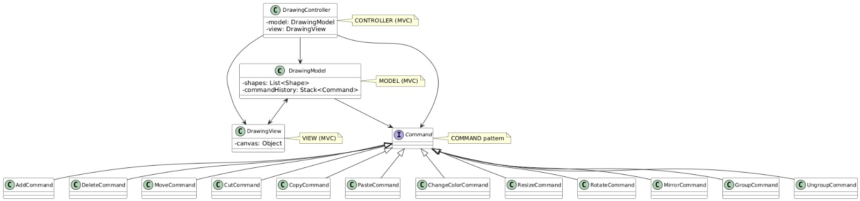
CLASS DIAGRAM
(Fig. 1) MVC Architecture and Command pattern

Slide 10
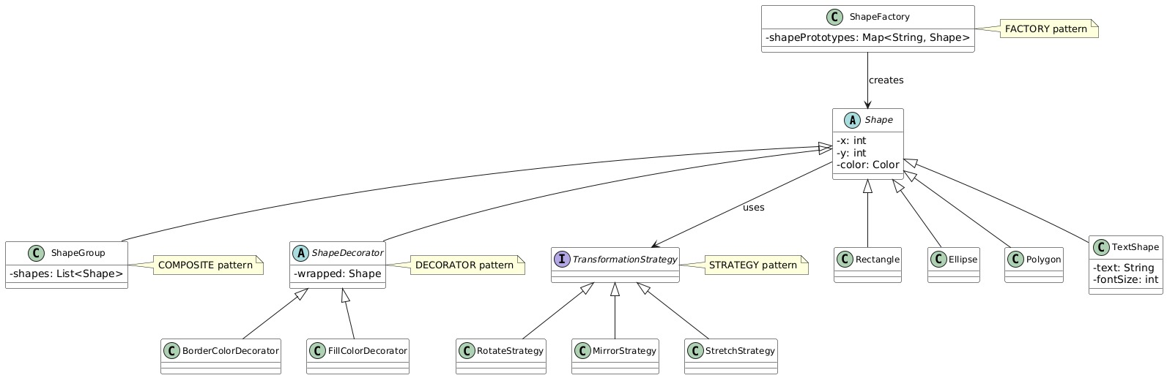
CLASS DIAGRAM
(Fig. 2) Factory, Composite, Decorator and Strategy patterns

Slide 11
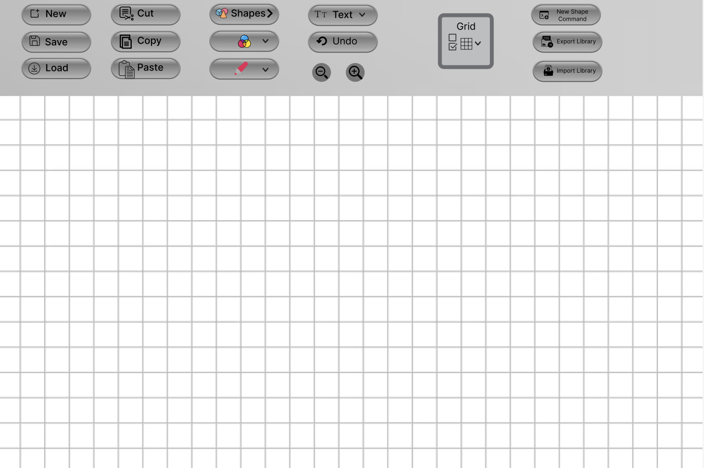
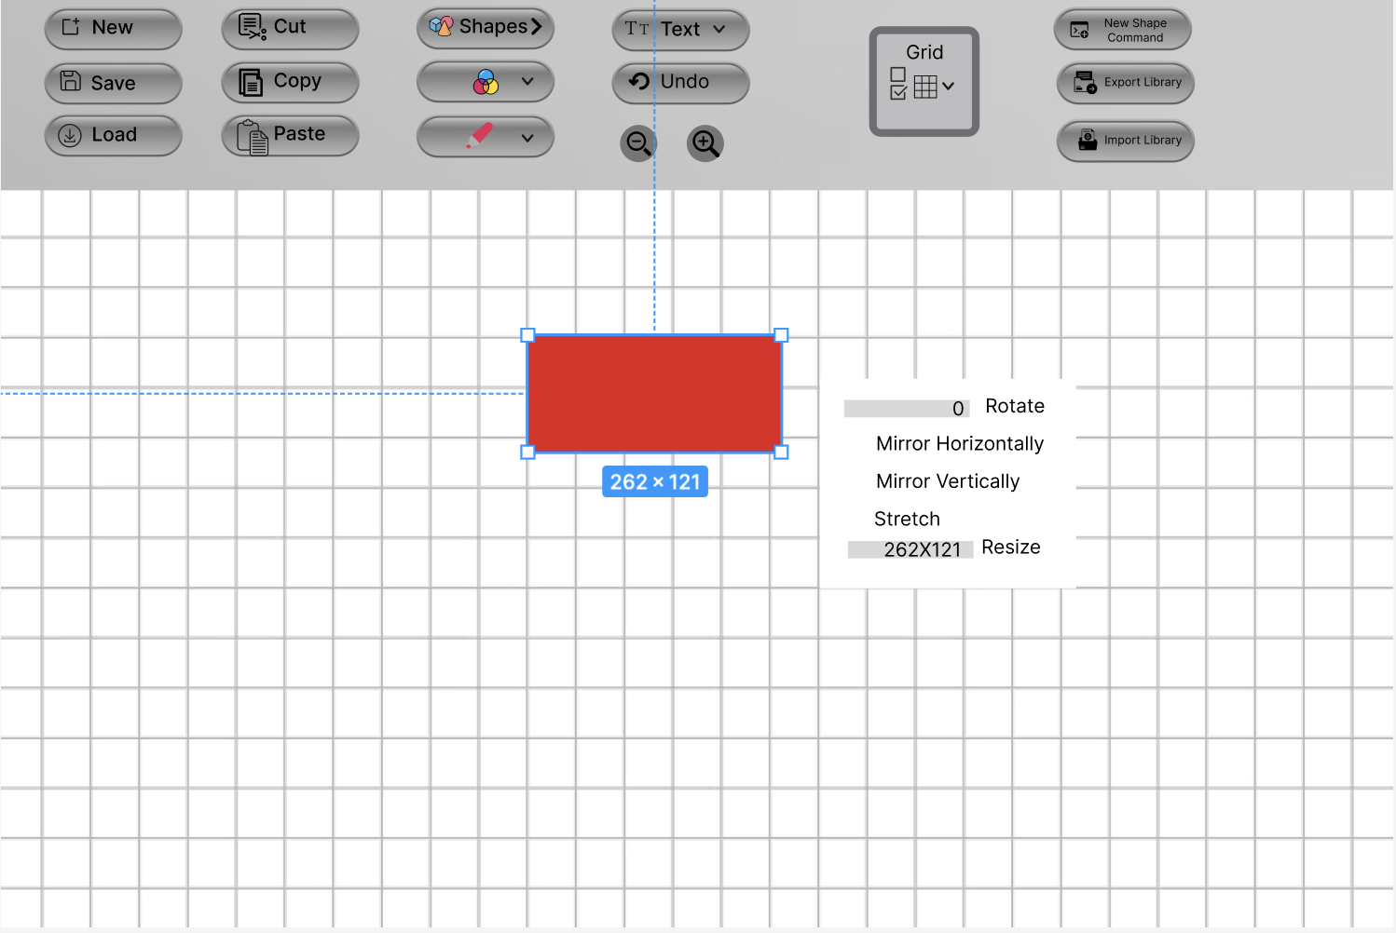
MOCK-UP INTERFACE
(Fig. 3) Empty canvas
(Fig. 4) Simple shape options

Slide 12
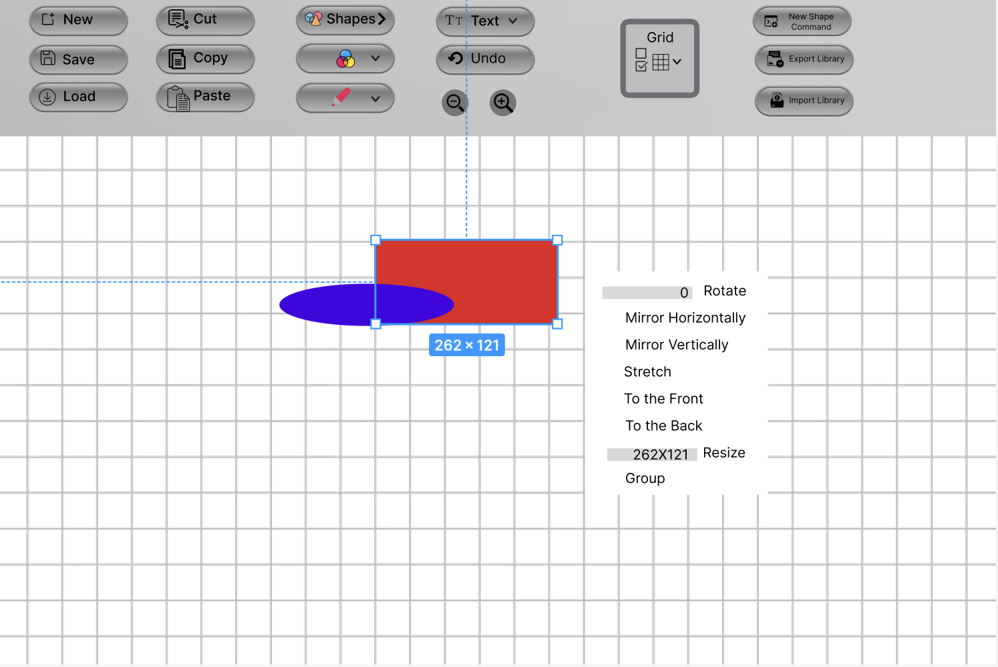

MOCK-UP INTERFACE
(Fig. 5) Overlap of simple shapes
(Fig. 6) Grouping of simple shapes

Slide 13
THANK YOU
Iannone Davide
Lomazzo Noemi
Petrone Gianluca
Sirica Simone

